Slide 1
Firms in the competitive market

Slide 2
Market structures
Perfect competition
Monopoly
Monopolistic
Oligopoly

Slide 3
Competitive market or Perfect Competition
Features
The Profit maximizing rule
Deciding how much to produce in a competitive market
What should be the price?

Slide 4
Perfect competition- features
Large number of buyers and sellers
The goods offered by the various sellers are largely the same (homogeneous product)
Free entry and exit of firms. This will require low sunk costs.
Buyers as well as sellers are Price Takers. Specifically ,all firms are price takers, therefore the firm’s demand curve is perfectly elastic.
There is perfect information and knowledge.

Slide 5

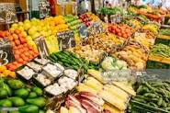

Examples of competitive market

Slide 6
Examples of perfect competition
Foreign exchange markets. Here currency is all homogeneous. Also, traders will have access to many different buyers and sellers. There will be good information about relative prices. When buying currency it is easy to compare prices
Agricultural markets. In some cases, there are several farmers selling identical products to the market, and many buyers. At the market, it is easy to compare prices. Therefore, agricultural markets often get close to perfect competition.
Internet related industries. The internet has made many markets closer to perfect competition because the internet has made it very easy to compare prices, quickly and efficiently (perfect information). Also, the internet has made barriers to entry lower. For example, selling a popular good on the internet through a service like e-bay is close to perfect competition. It is easy to compare the prices of books and buy from the cheapest. The internet has enabled the price of many books to fall in price so that firms selling books on the internet are only making normal profits.

Slide 7
The profit maximization rule
Π* The profit is maximized at output (Q) level where MC =MR
Marginal Cost is cost incurred to produce one extra unit of output.
Marginal revenue is revenue generated from one extra unit of output
This rule applies to all the four market structures (perfect competition, monopoly, monopolistic and oligopoly)

Slide 8
Competitive market (P = Ar=Mr=Demand)
Quantity | Price | Total revenue (P× Q) | Average Revenue (AR = TR/ Q) | Marginal Revenue (MR = ∆TR / ∆ Q)
1 | 6 | 6 | 6 | 6
2 | 6 | 12 | 6 | 6
3 | 6 | 18 | 6 | 6
4 | 6 | 24 | 6 | 6
5 | 6 | 30 | 6 | 6
6 | 6 | 36 | 6 | 6
7 | 6 | 42 | 6 | 6
8 | 6 | 48 | 6 | 6

Slide 9
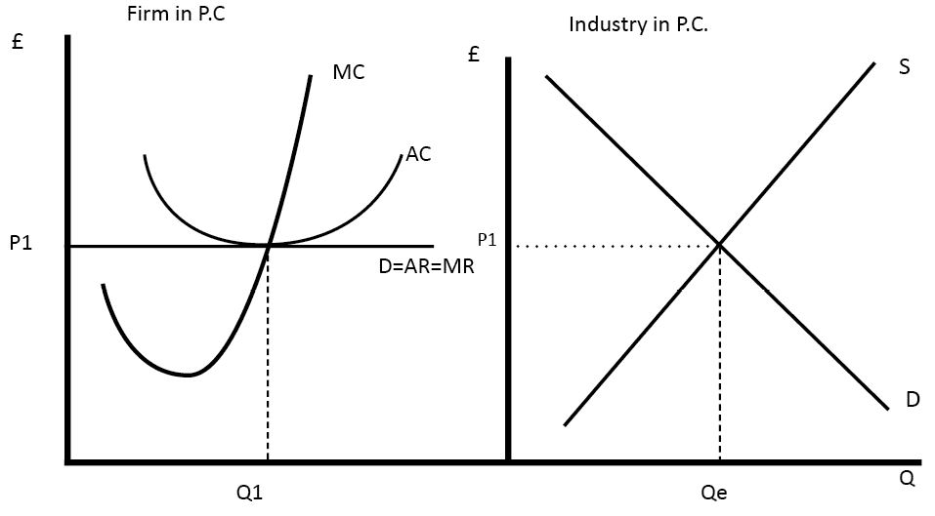
Diagram for perfect competition

Slide 10
From the above diagram…
The industry price is determined by the interaction of Supply and Demand, leading to a price of Pe.
The individual firm will maximise output where MR = MC at Q1
In the long run firms will make normal profits.

Slide 11
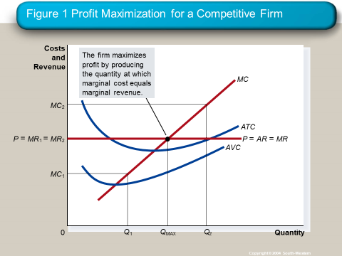
Profit maximization for competitive firm
Qty | TR | TC | Profit (TR-TC) | MR | MC | Change in Π
0 | 0 | 3 | -3
1 | 6 | 5 | 1 | 6 | 2 | 4
2 | 12 | 8 | 4 | 6 | 3 | 3
3 | 18 | 12 | 6 | 6 | 4 | 2
4 | 24 | 17 | 7 | 6 | 5 | 1
5 | 30 | 23 | 7 | 6 | 6 | 0
6 | 36 | 30 | 6 | 6 | 7 | -1
7 | 42 | 38 | 4 | 6 | 8 | -2
8 | 48 | 47 | 1 | 6 | 9 | -3

Slide 12
Price = Marginal Cost (MC)
From the above diagram we know that
Price = MR=AR= D
From profit maximization rule we know MC =MR
Then P = MC

Slide 13
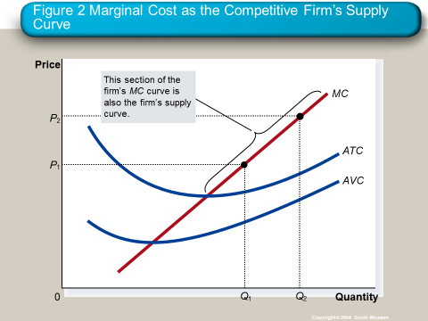
Price = marginal cost
The firm’s marginal cost curve determines the quantity of good the firm is willing to supply at any price, the marginal cost curve is also competitive firm’s supply curve.

